Slide 1

Chipy
Job Scene in Chicago

Slide 2
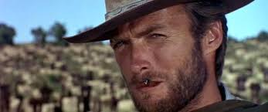
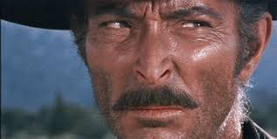
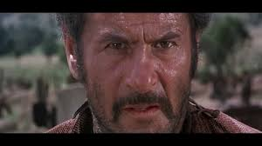
Presenting….
The Good
The Bad
The Ugly

Slide 3








The Good
Lots of roles for seasoned developers!
For example, I’ve been contacted by

Slide 4

The Bad
see https://www.youtube.com/watch?v=YbYWhdLO43Q or google “squatty potty”

Slide 5
The Bad..cont.
Heavy demand for seasoned developers
Less interest in junior developers
“Full stack...and more”

Slide 6
The Ugly
After the ‘seasoned’ hurdle, fit is hard
10-20 to a hire
interesting interview questions, i.e invert a binary tree
multiple, multiple interviews
other factors

Slide 7
Some details
Salary

Slide 8
Goals
Help find Python professionals a gig (not that they need help, but….)
Get a referral for Chipy (keep the beer free)
Grow the community

Slide 9
Improvements
More resume review
Look to encourage firms to take a chance on younger developers
support the mentorship program, look to grow it

Slide 10
Questions/Comments?
Thanks!

